Slide 1
CHATBOT
USING DIALOGFLOW

Slide 2
EDUCATIONAL INSTITUTIONS

Slide 3

KIET GROUP OF INSTITUTIONS

Slide 4
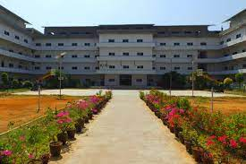
OUR OUR COLLEGE

Slide 5

CSE

Slide 6

OUR BRANCHES

Slide 7

ARTIFICIAL INTELLIGENCE

Slide 8

DATA SCIENCE SCIENCE

Slide 9

MACHINE LEARNING

Slide 10

CYBERCYBER SECURITY SECURITY

Slide 11

KIET
OUR COLLABORATIONS

Slide 12
THANK YOU

